Slide 1

Parallel Processing
MIDTERM QUESTION

Slide 2
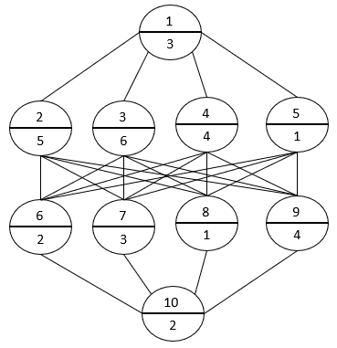
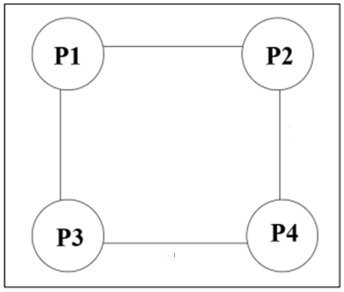
Parallel Processing
The diagram shows below the program graph
Static Connection 2D (hypercube)
2
2
2
2

Slide 3
P1
P2
P3
P4
J1
I
I
I
3
3
3
3
J3
T
T
T
5
5
J4
7
J2
J5
8
9
9
9
I
10
T
T
T
T
12
J9
13
13
14
J8
J7
2
J6
15
16
15
16
T
19
2
2
J10
21
2

Slide 4
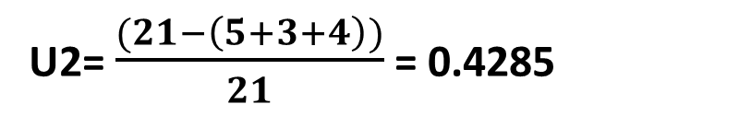
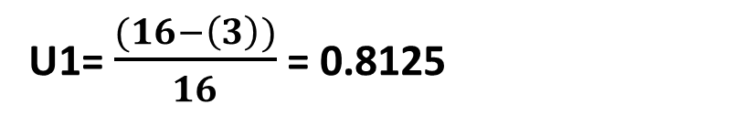
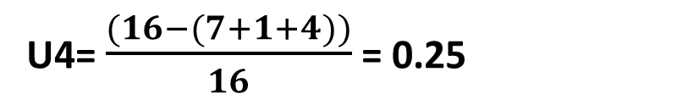
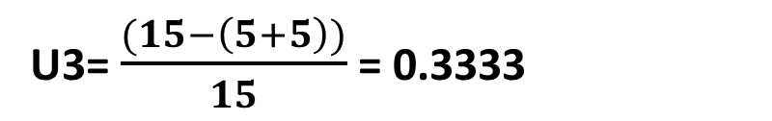
Calculate efficiency for each processor
U1= $\frac{(16−\left(3\right))}{16}$ = 0.8125
U2= $\frac{(21−\left(5+3+4\right))}{21}$ = 0.4285
U3= $\frac{(15−\left(5+5\right))}{15}$ = 0.3333
U4= $\frac{(16−(7+1+4))}{16}$ = 0.25
Average Utilization= $\frac{(0.8125+0.4285+0.3333+0.25)}{4}$ = 0.4560

